Slide 1
Age Introduction

Slide 2
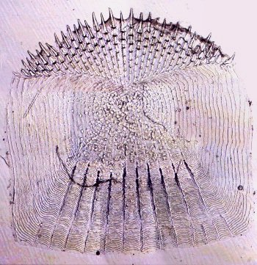
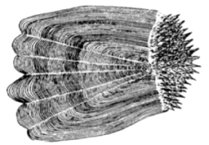
Ctenoid Scales

Slide 3
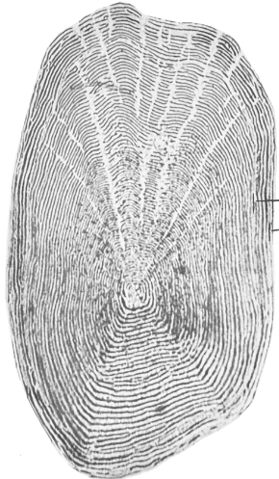
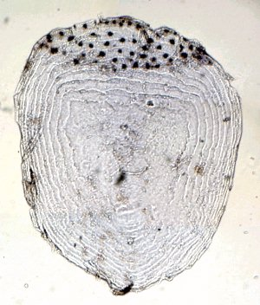
Cycloid Scales

Slide 4
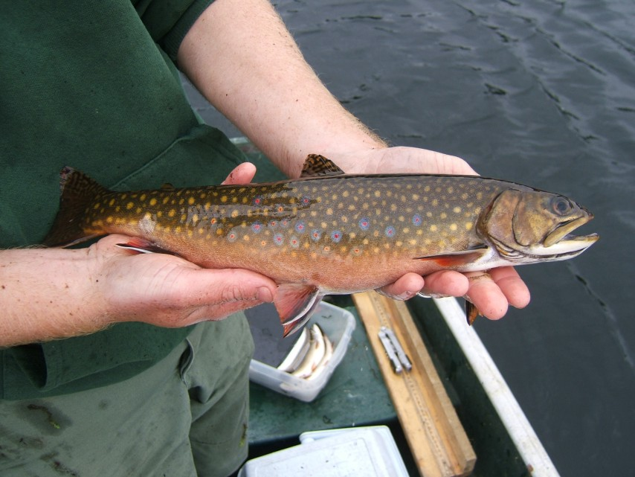
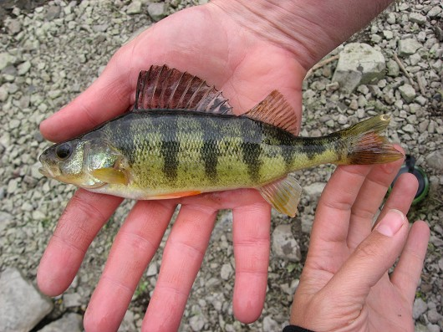
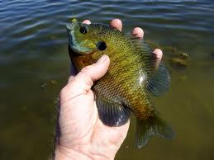
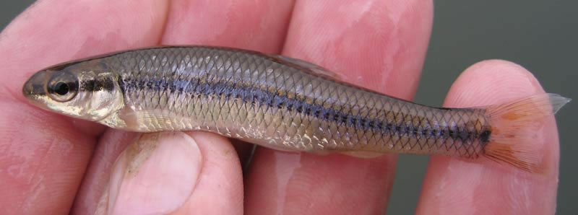
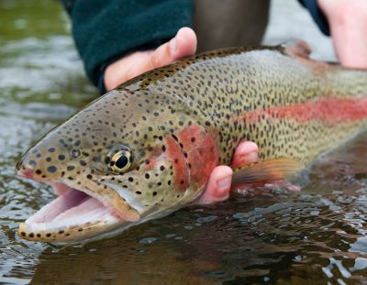
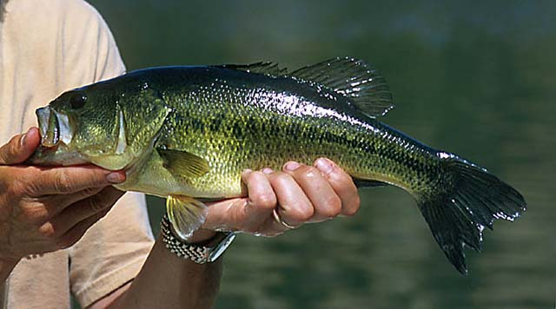
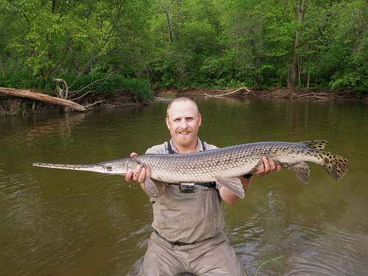
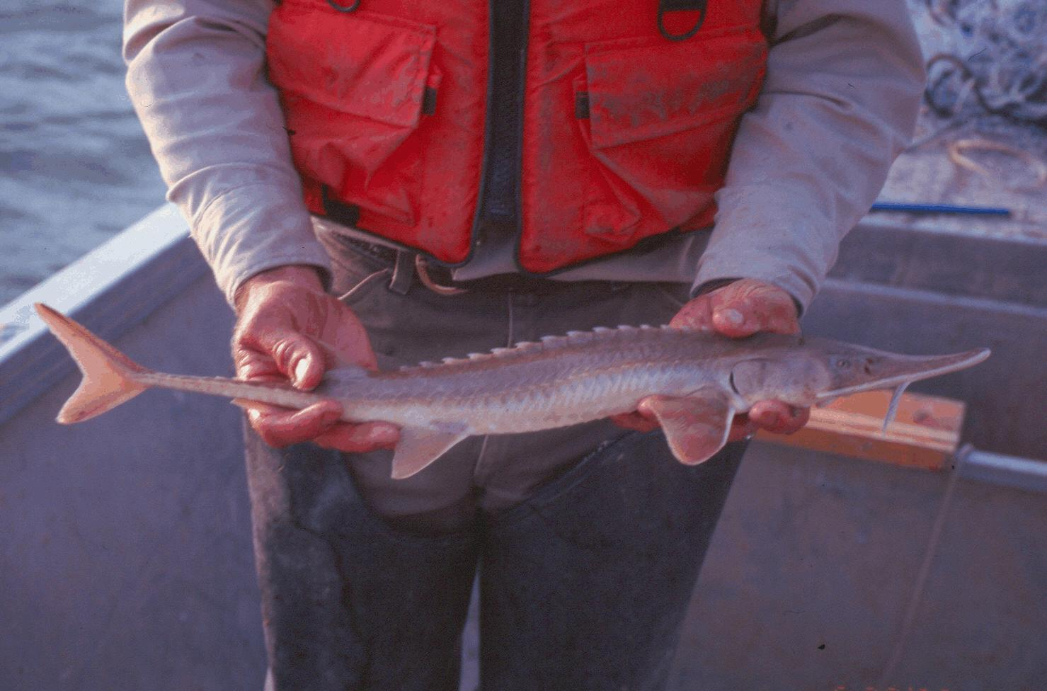
Type of Scale for …
Brook trout
Yellow perch
Bluegill
Bluntnose minnow
Rainbow trout
Largemouth bass
Longnose gar
Shovelnose sturgeon

Slide 5
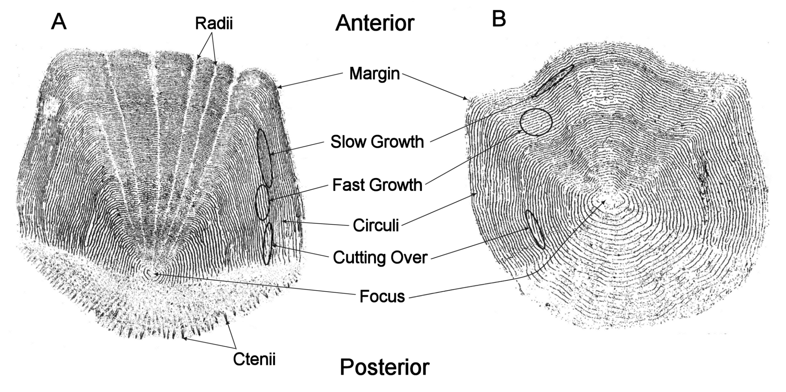
Scale Language

Slide 6
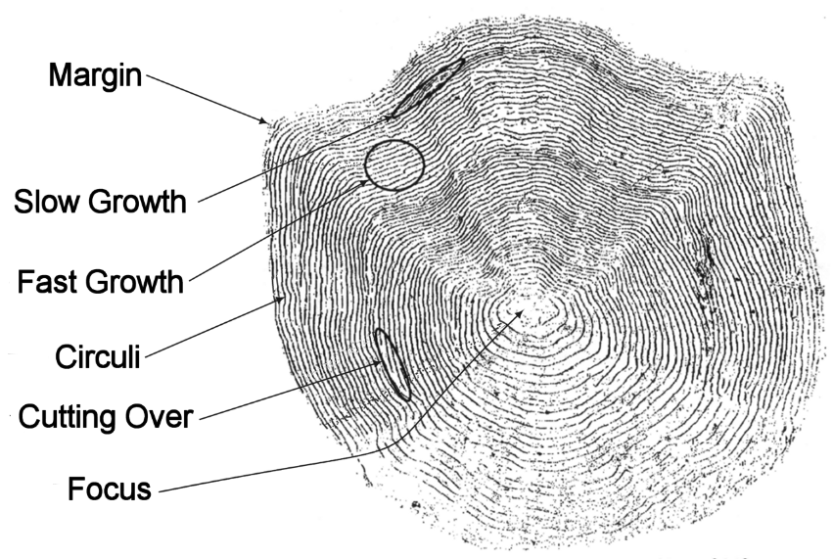
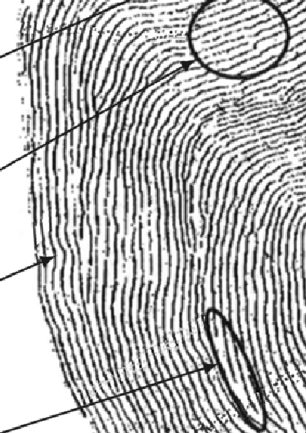
Annulus Characteristics

Slide 7
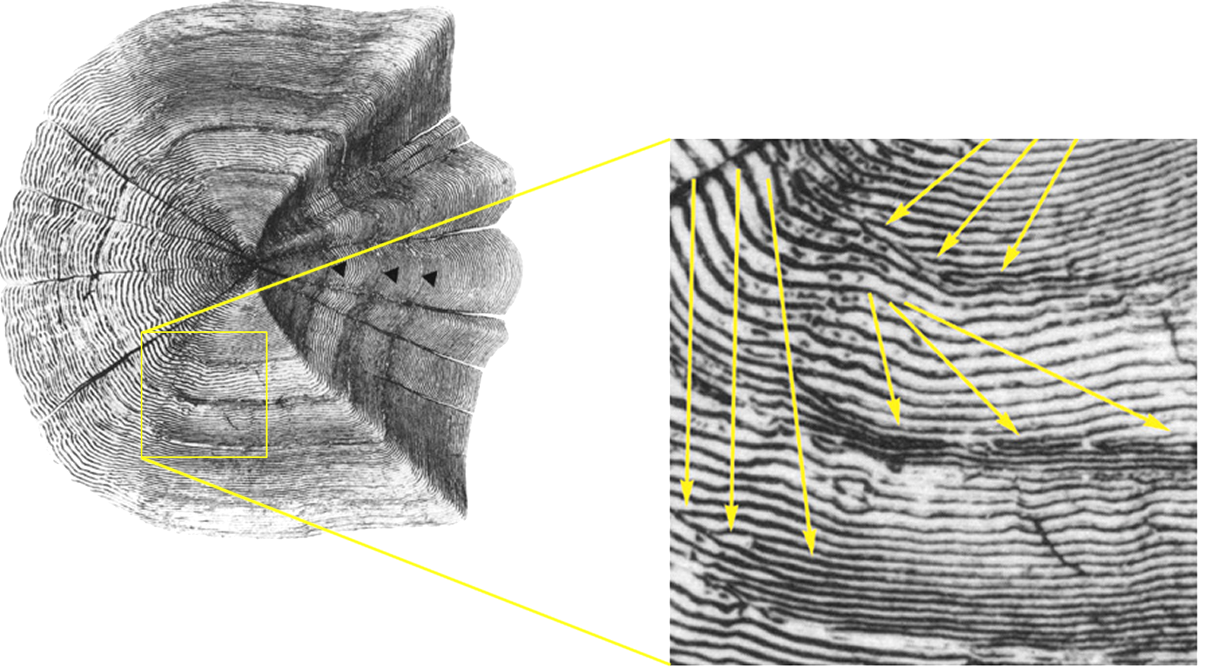
Annulus Characteristics

Slide 8
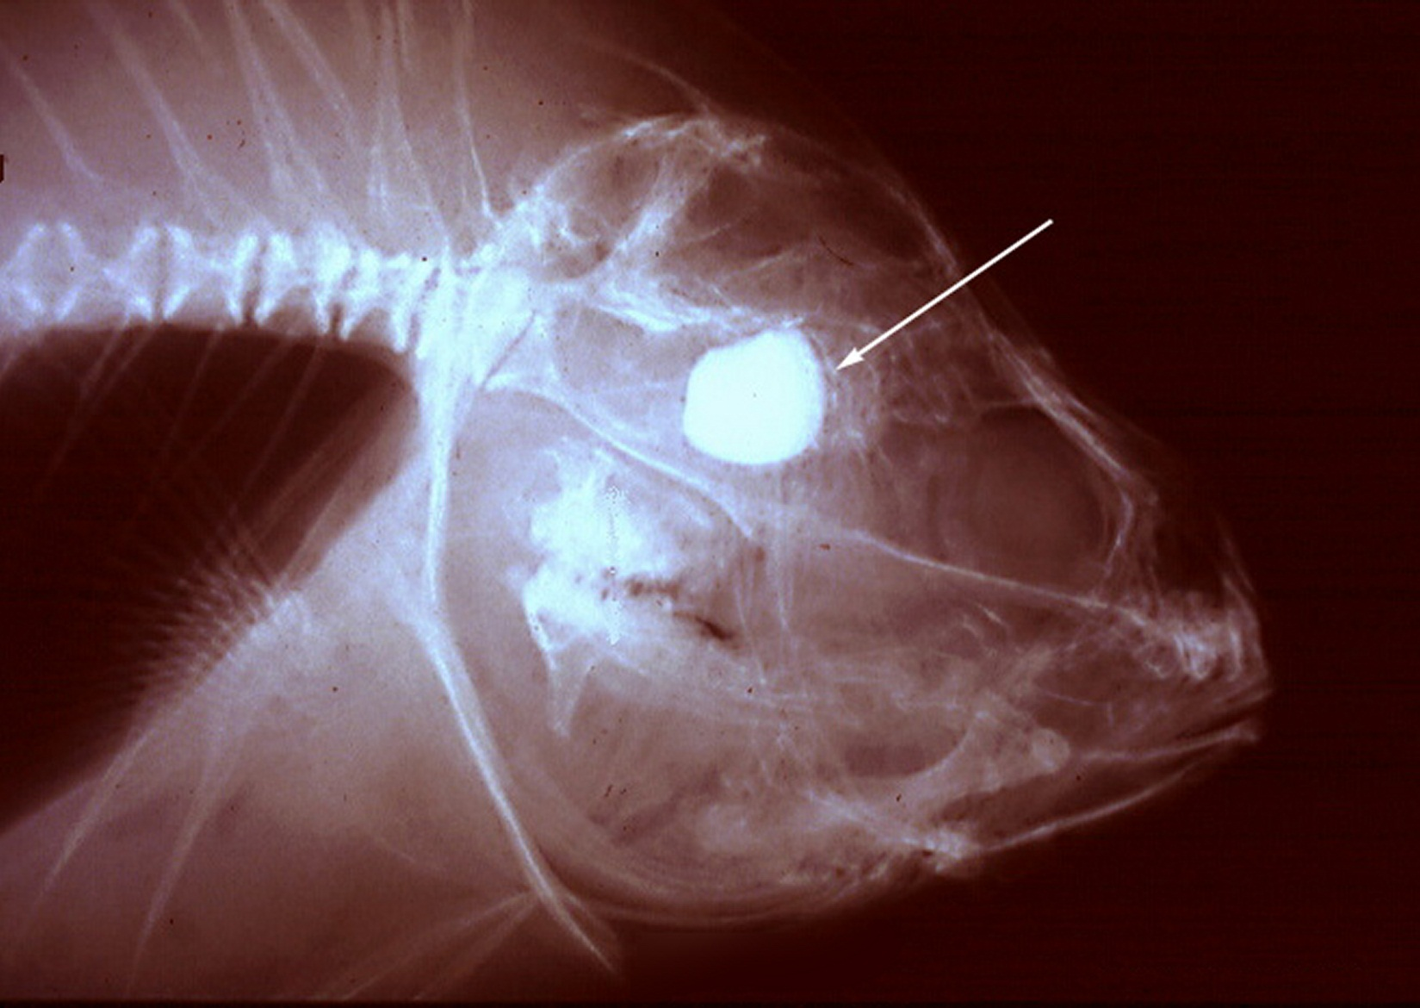
Otoliths
Notes:
Freshwater Drum … from George Spangler

Slide 9

Otolith Extraction

Slide 10
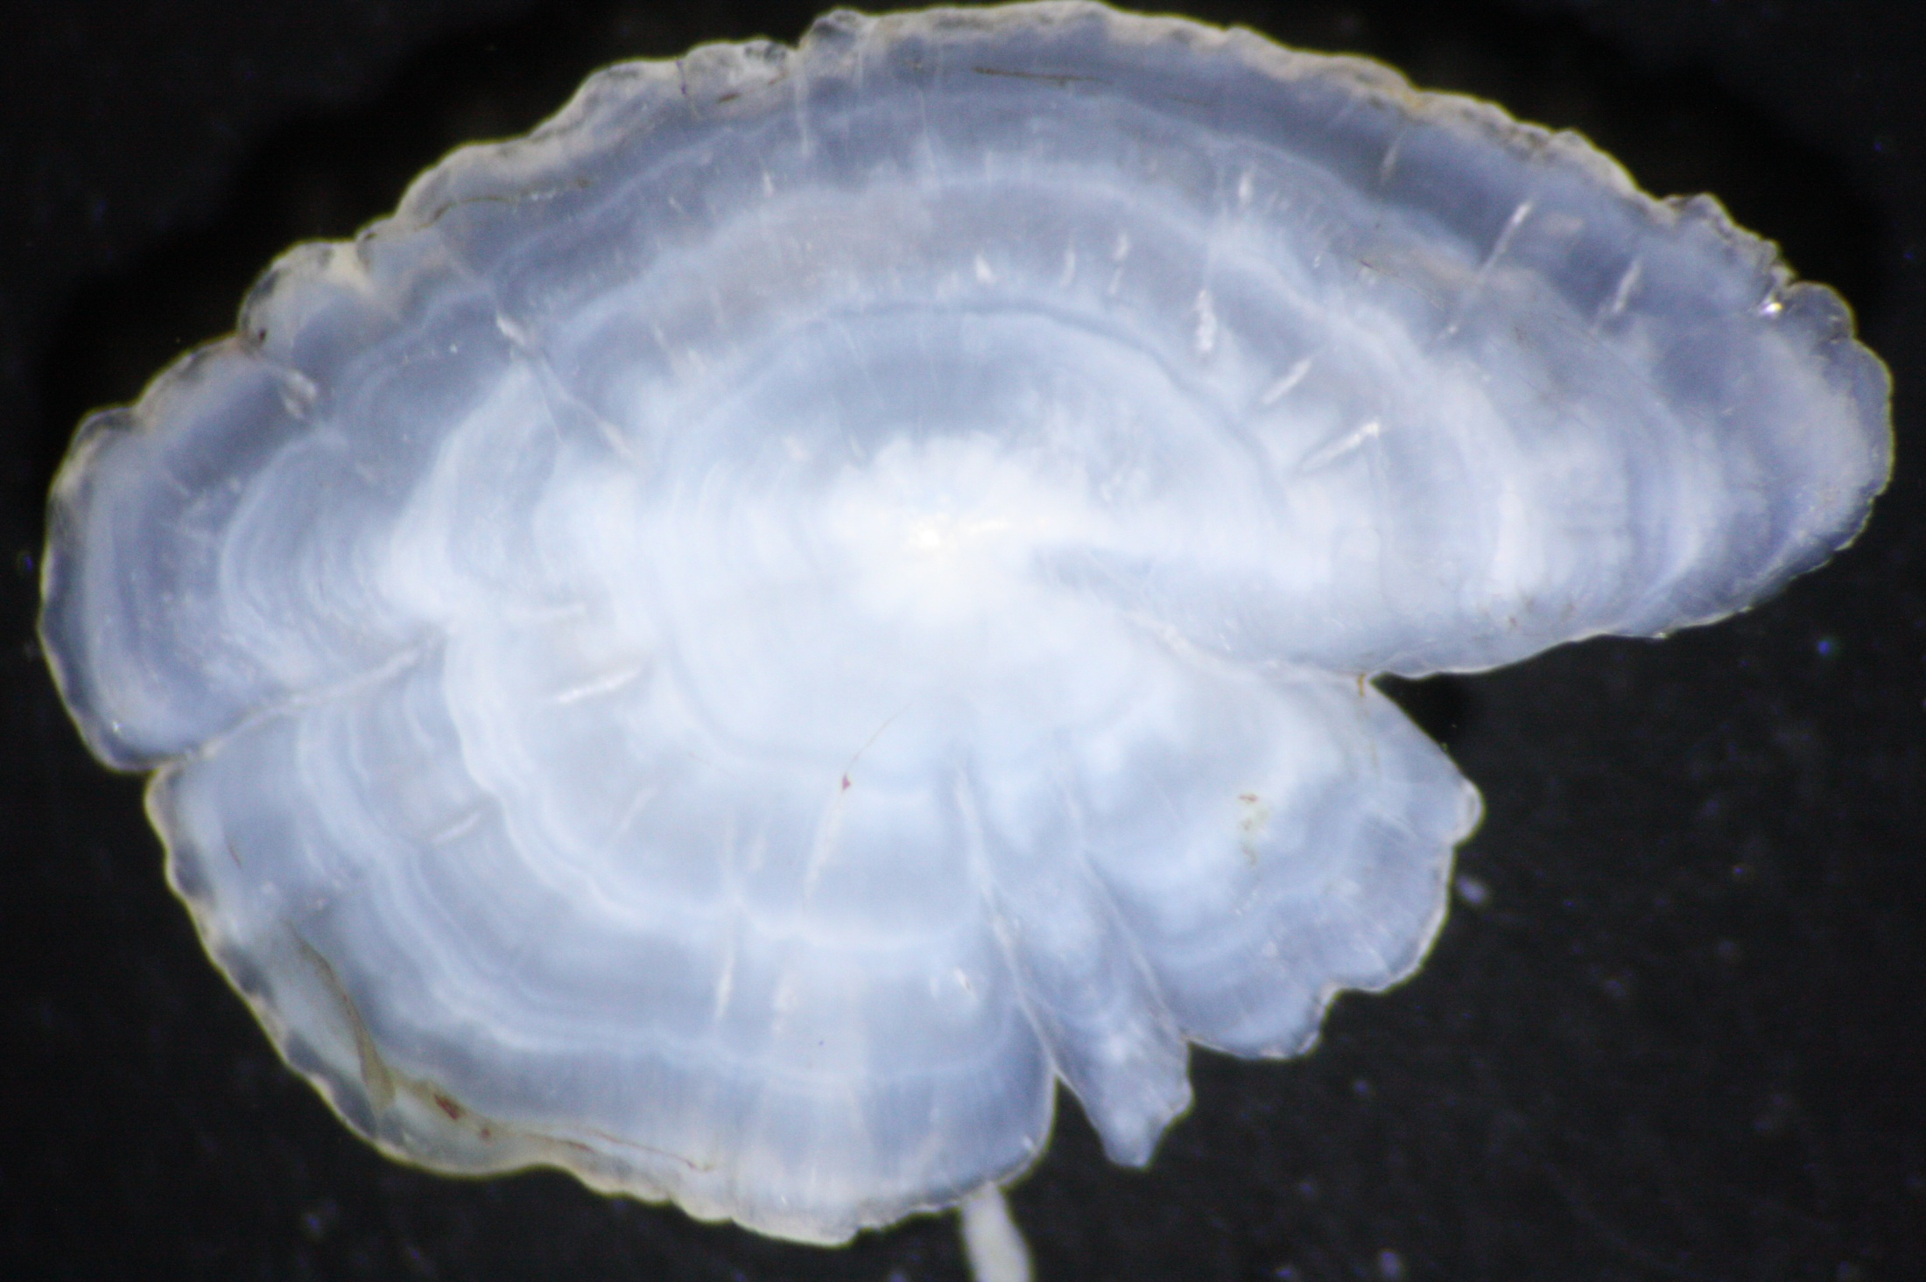
Notes:
Black Crappie whole otolith … from Dan Isermann (UWSP)

Slide 11
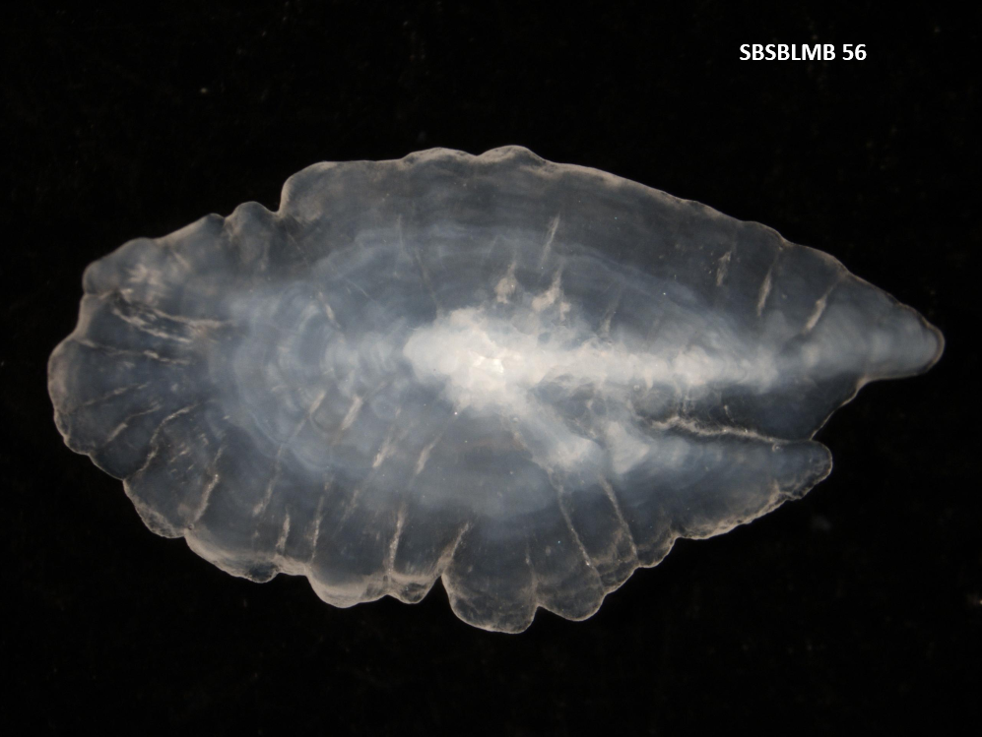
SBSBLMB 56
Notes:
Walleye whole otolith … from Dan Isermann (UWSP)

Slide 12
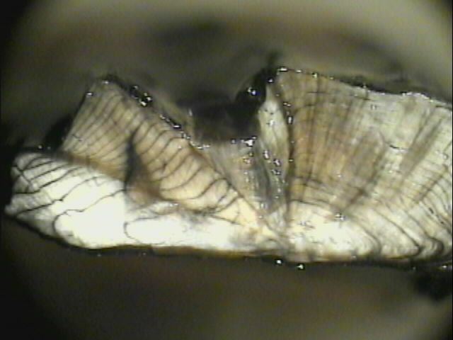
Notes:
Walleye otolith crack-and-burn … from Dan Isermann (UWSP)

Slide 13
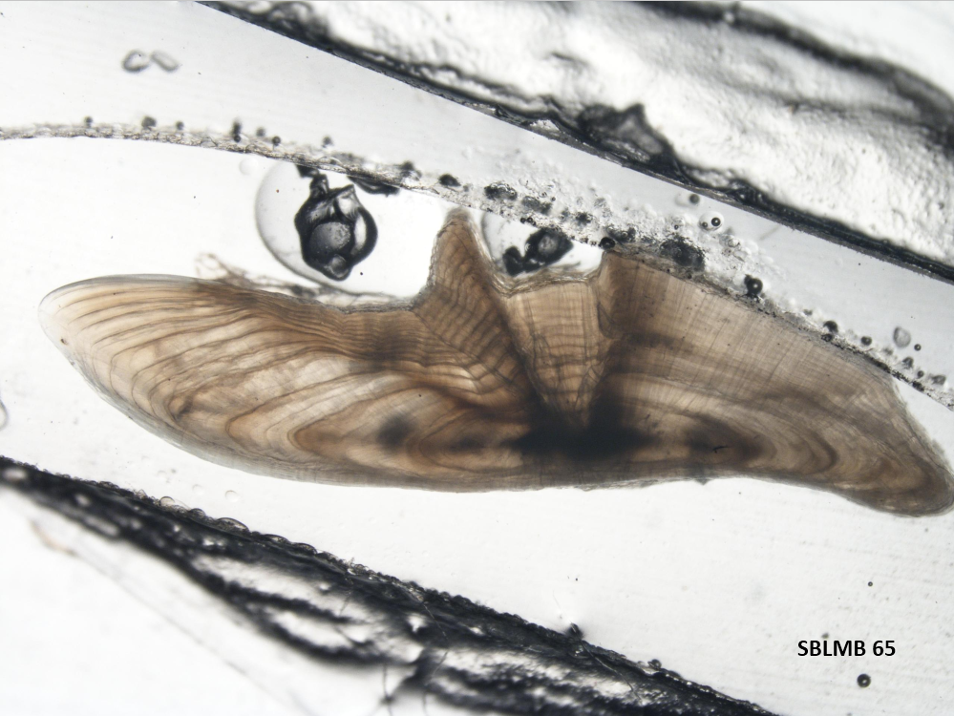
SBSBLMB 56
Notes:
Walleye otolith sction … from Dan Isermann (UWSP)

Slide 14
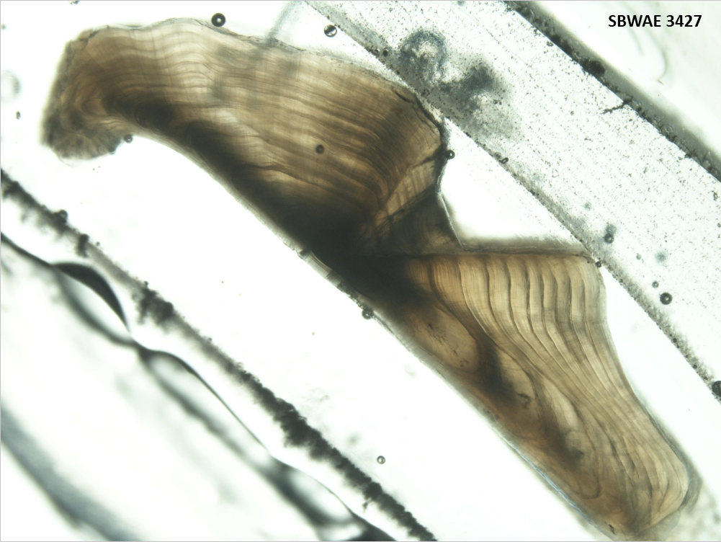
SBSBLMB 56
Notes:
Walleye otolith section … from Dan Isermann (UWSP)

Slide 15
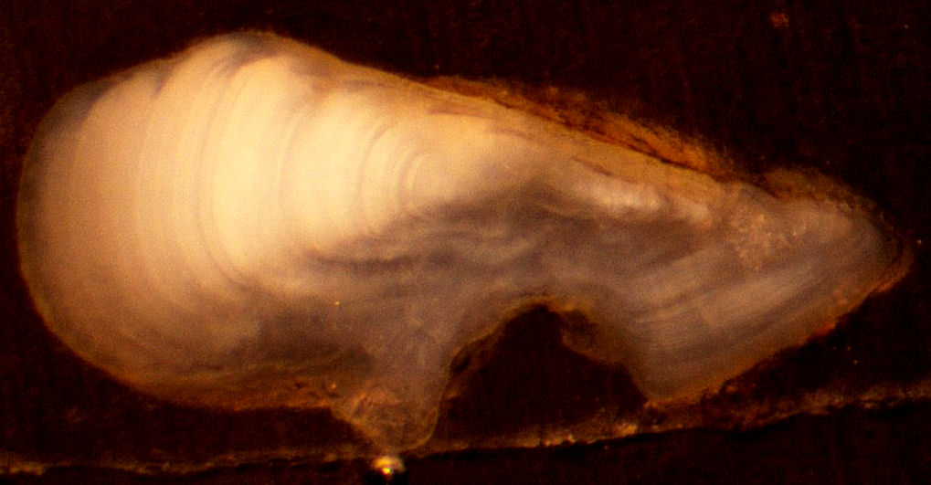
Notes:
Pygmy Whitefish otolith section – from Taylor Stewart

Slide 16
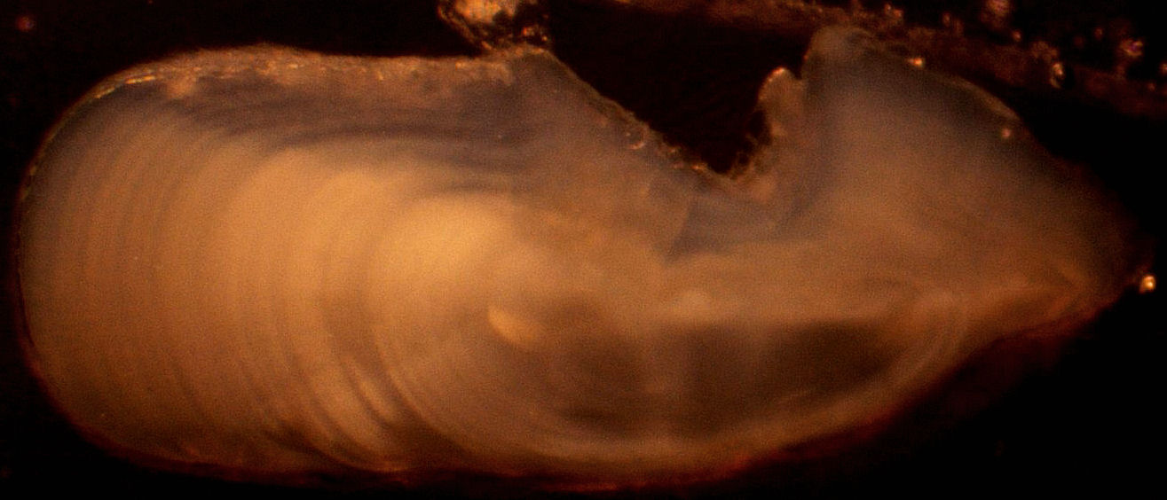
Notes:
Pygmy Whitefish otolith section – from Taylor Stewart

Slide 17
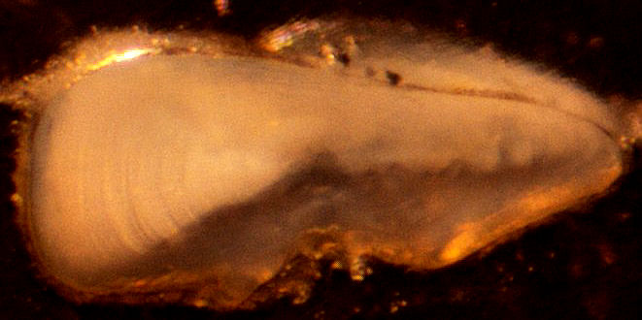
Notes:
Pygmy Whitefish otolith section – from Taylor Stewart

Slide 18
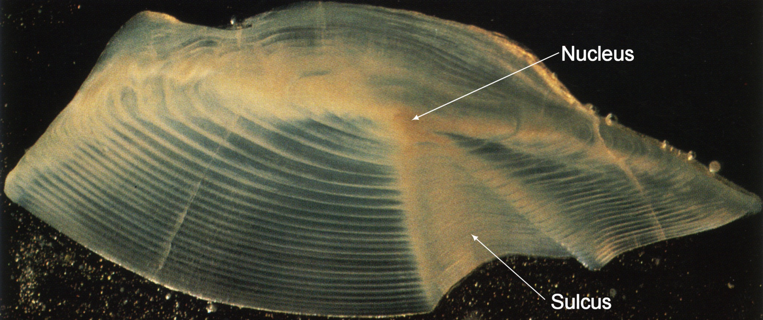
Otolith Language
Annuli
Notes:
Freshwater Drum … from Lyn Bergquist

Slide 19
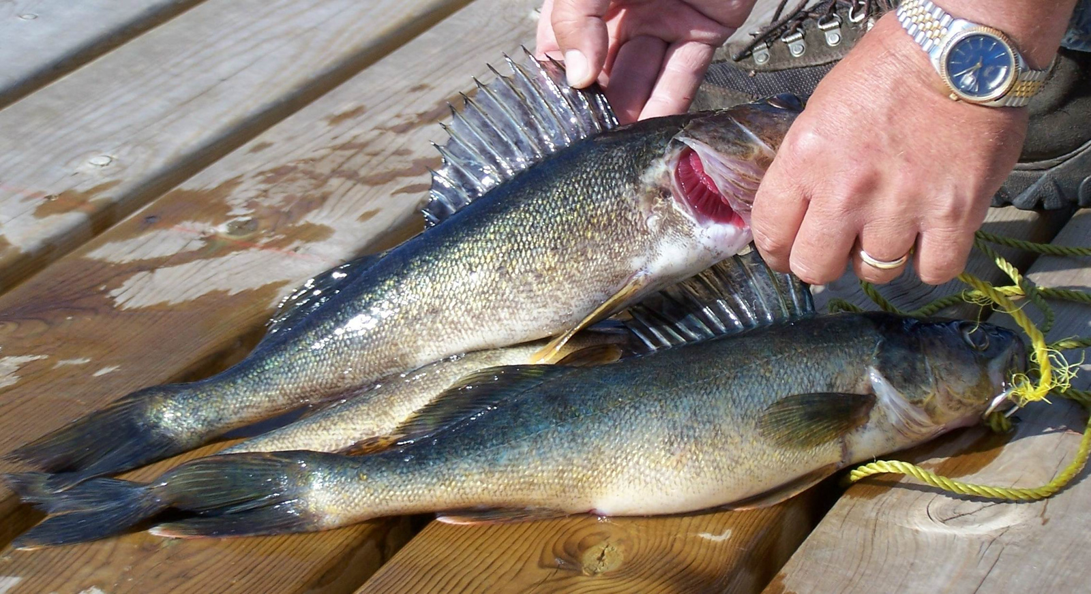
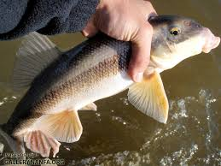
Spines / Fin Rays

Slide 20
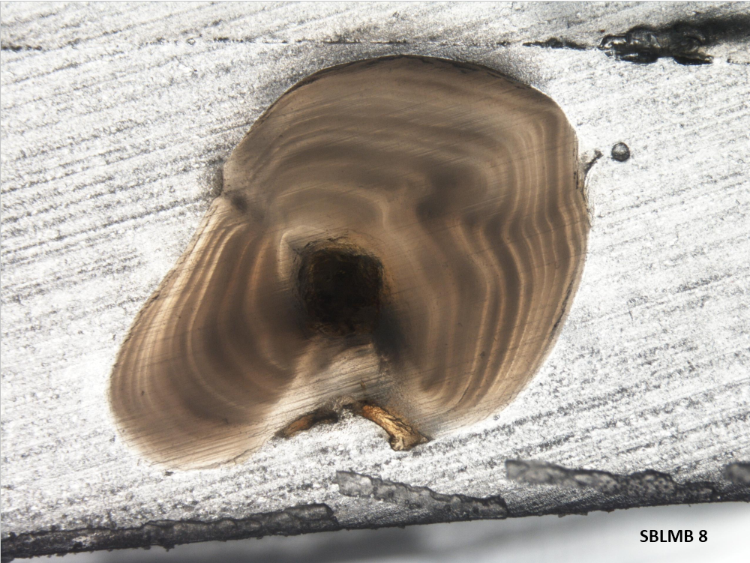
Notes:
Largemouth Bass dorsal spine – from Dan Isermann (UWSP)

Slide 21
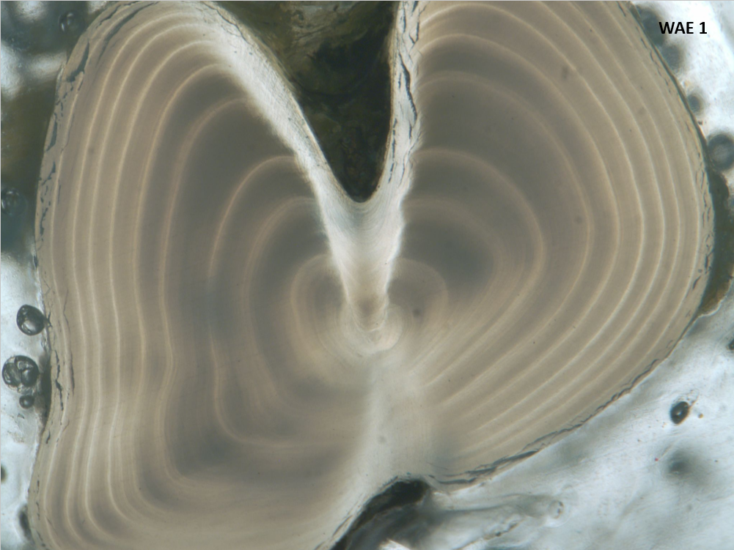
Notes:
Walleye dorsal spine – from Dan Isermann (UWSP)

Slide 22
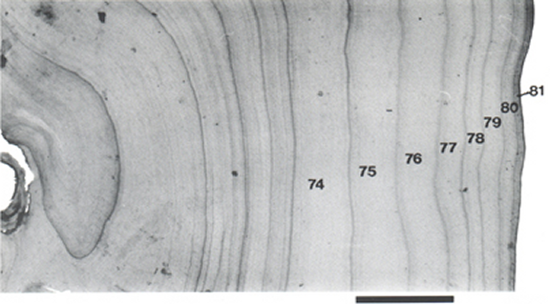

Slide 23
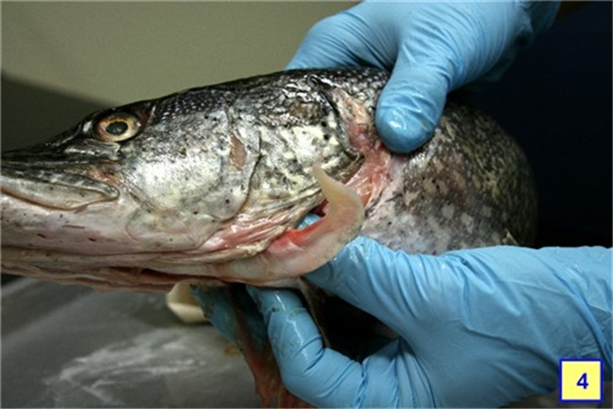
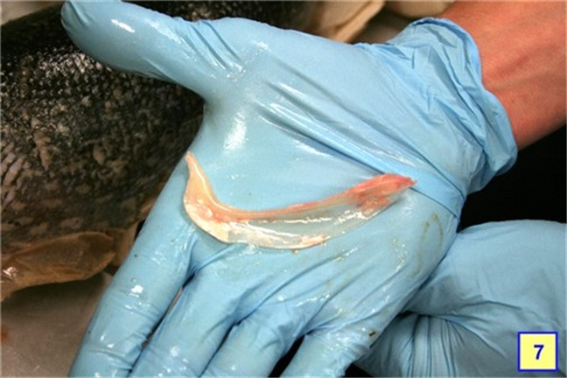
Cleithrum

Slide 24
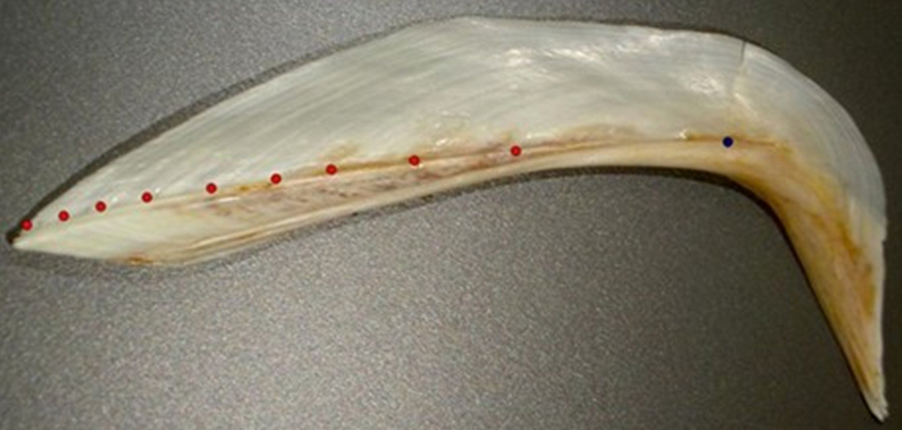

Slide 25
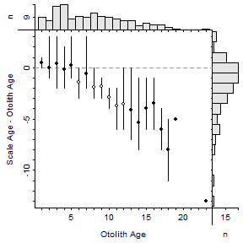
Structure Comparisons
Notes:
Lake Champlain Lake Whitefish

Slide 26
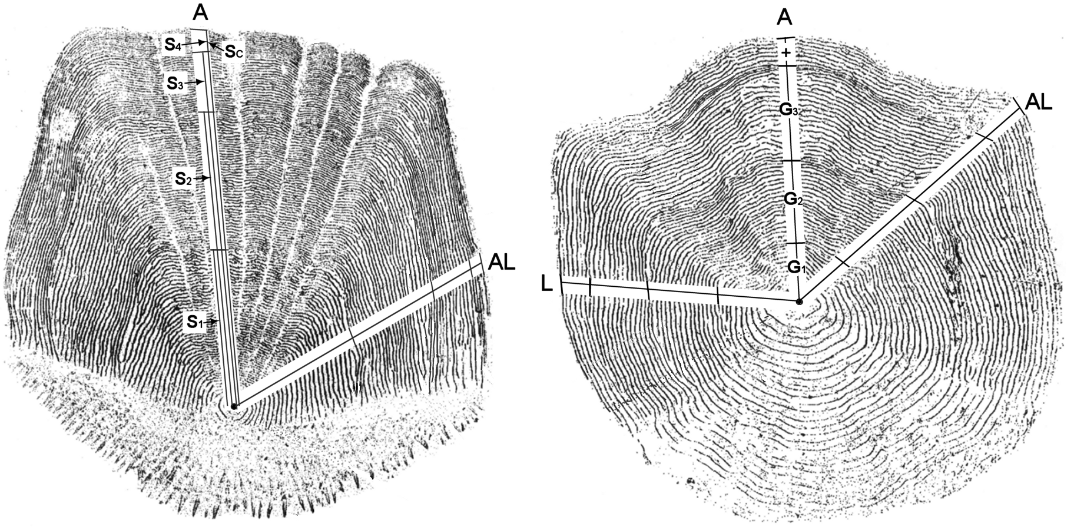
Back-Calculation
Estimate previous fish length from scale size
IDEA – proportional growth on scale equals proportional growth of fish
i.e., if S₁ is 30% of S_{c} then L₁ is 30% of L_{c}

